Slide 1
Optical Design Guidelines for DLP® products
March 08, 2024

Slide 2
Topics
Introduction to DLP Technology
DMD Optical Properties
Projection Architecture and Design
  Light Source Illuminator System Design
  Illumination Relay Design
  Projection Lens Considerations
Resolution Enhancement
Introduction to Colorimetry & Systems Lumens Budgeting
Stray Light Mitigation
Phase Light Modulator Update

Slide 3
Introduction to DLP Technology
For more information, refer to application report “Getting Started With TI DLP® Display Technology” https://www.ti.com/lit/pdf/dlpa059

Slide 4
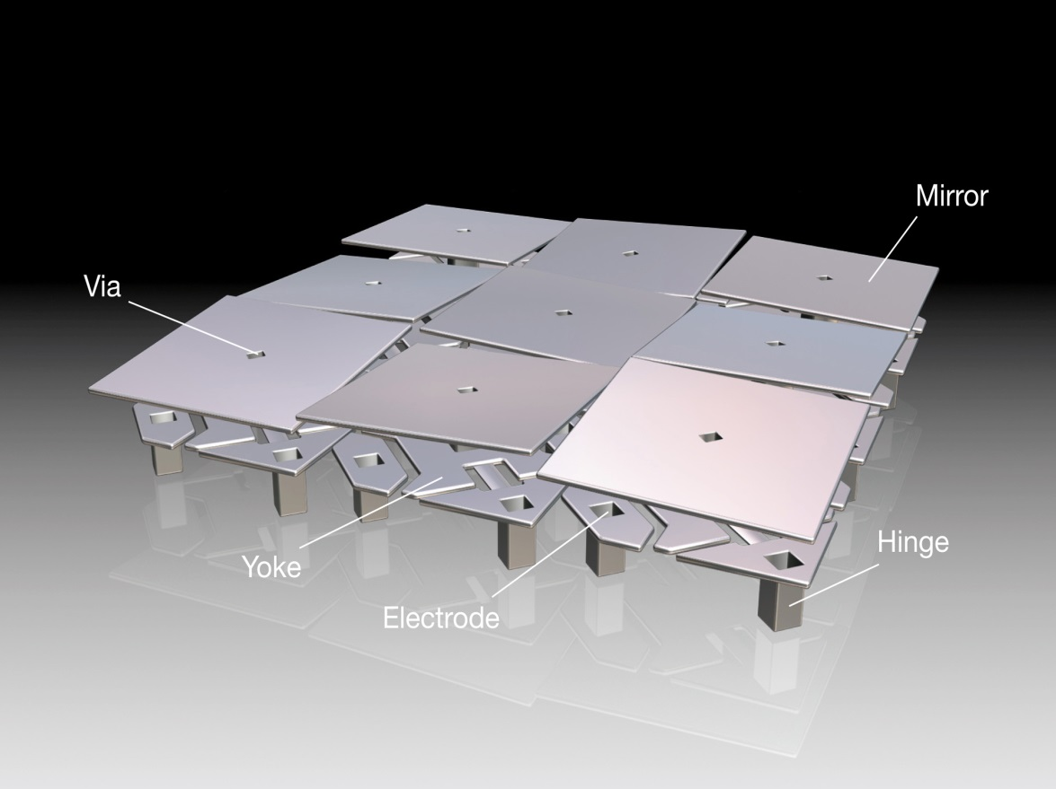
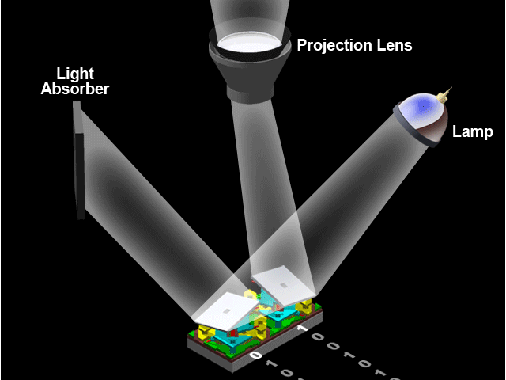

DLP Technology: Millions of Mirrors
Optical MEMS (Micro-Electro-Mechanical System) device
Up to 8 Million micro-mirrors
Over 20,000 cycles/second
Extremely high fill factor
Quintillion tested cycles
The industry leader in:
Digital Cinema, Projection, and MEMS
Extremely Flexible and Programmable Light Management

Slide 5
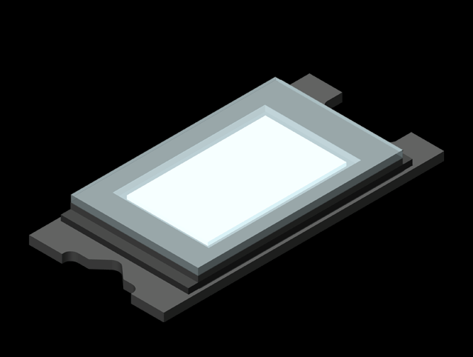
DLP® how it works
How DLP Technology Works
Notes:
<<ANIMATION – NO NOTES>>

Slide 6
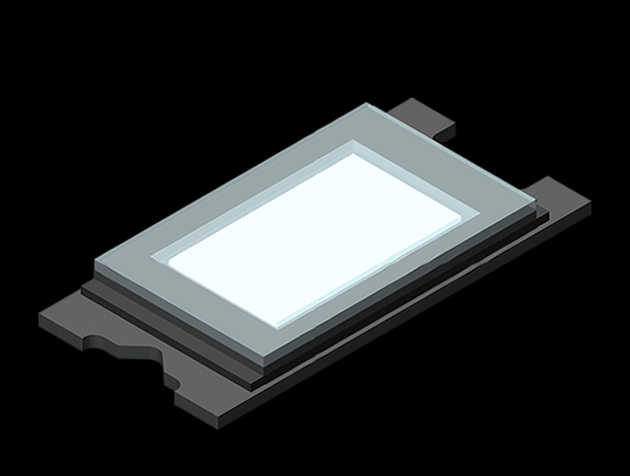
DLP® how it works
How DLP Technology Works
Notes:
<<ANIMATION – NO NOTES>>

Slide 7

DLP® how it works
How DLP Technology Works
Notes:
<<ANIMATION – NO NOTES>>

Slide 8
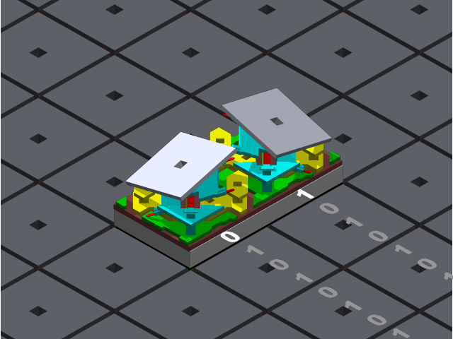
DLP® how it works
How DLP Technology Works
Notes:
<<ANIMATION – NO NOTES>>

Slide 9
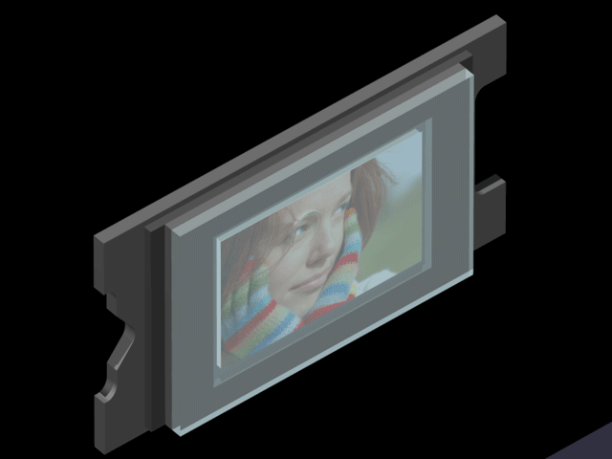
Single chip LED DLP® solution
How DLP Technology Works
Notes:
<<ANIMATION – NO NOTES>>

Slide 10
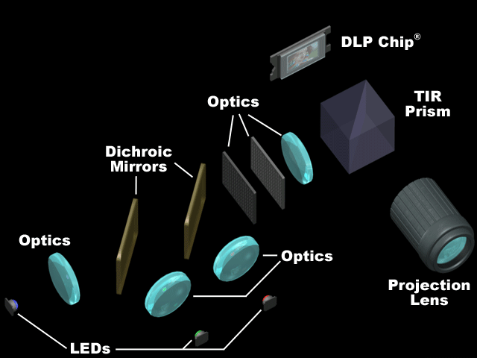
Single chip LED DLP® solution
How DLP Technology Works
Notes:
<<ANIMATION – NO NOTES>>

Slide 11
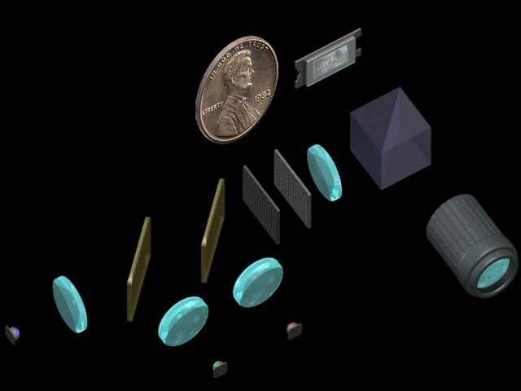
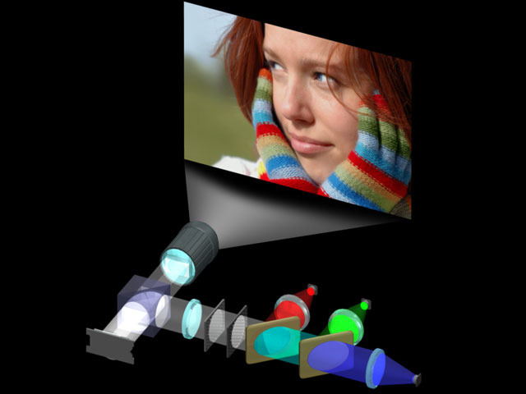
Single chip LED DLP® solution
How DLP Technology Works
Notes:
<<ANIMATION – NO NOTES>>

Slide 12
Digital Micromirror Devices (DMD)
Optical Properties

Slide 13

Etendue - Important concept
Quantifies how much space the light takes up spatially and angularly
Measure of system throughput capability
  Sometimes called “extent” or “invariant”
  Throughput limited by element with smallest etendue
DMD Etendue
  Solid angle limited by mirror tilt angle
  Smaller DMD diagonal = smaller area
  Small Etendue makes it more difficult to couple light
Solid Angle
Area
Practical definition:
$$Etendue ≅ π ×Area × \sin^{2}{θ}$$
$$Etendue ≅Area ×Solid Angle$$
For more information, visit: https://training.ti.com/etendue-how-brief-introduction-etendue-projection-systems

Slide 14
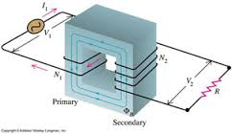
Etendue: LED source illustration
Note: inverse relationship between beam size and beam angle
LED
$d_{3}>d_{2}>d_{1}$ and ${ θ}_{1}>θ_{2}>θ_{3}$ but…
DMD
$$d_{1}{sinθ}_{1}{=}d_{2}{sinθ}_{2}{=}d_{3}{sinθ}_{3}{=}\text{constant}$$
Constant depends on
source Etendue
Electrical transformer analogy:
Power (constant) = current x voltage
Etendue (constant) = area x tilt angle

Slide 15
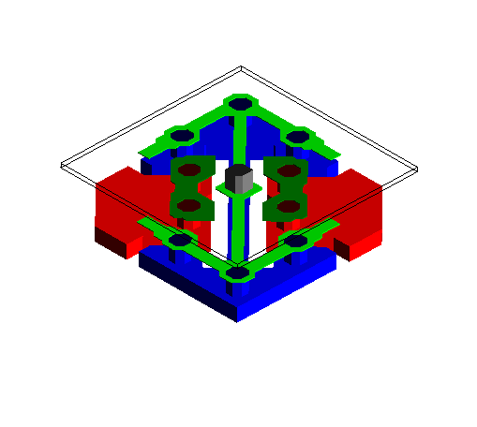
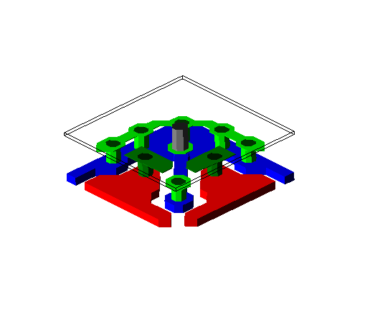
About the Pixels
Torsional Design
(12° or 14.5° tilt)
Illumination
Off-state
 | Acronym | Name | Year Introduced | Mirror Pitch
Torsional | FTP | Fast Track Pixel | 2003 | 13.68μm
 | SPD | Small Pixel Development | 2004 | 10.8μm
 | VSP | Voltage Scale Pixel | 2007 | 7.6μm
 | HEP | High Efficiency Pixel | 2019 | 9.0μm
 | SST | Single Spring Tip | 2023 | 5.4μm
 | RDP | Resolution Density Pixel | 2024 | 4.5μm
Cantilever | TRP | Tilt and Roll Pixel | 2013 | 5.4μm
‘Manhattan’ configuration
‘Diamond’ configuration
Cantilever Design
(17° effective)
Off-state
Illumination
‘Manhattan’ configuration

Slide 16
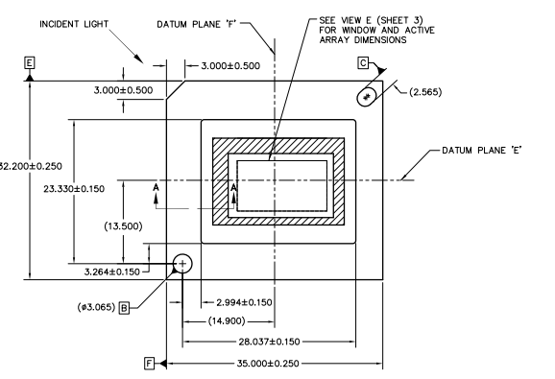
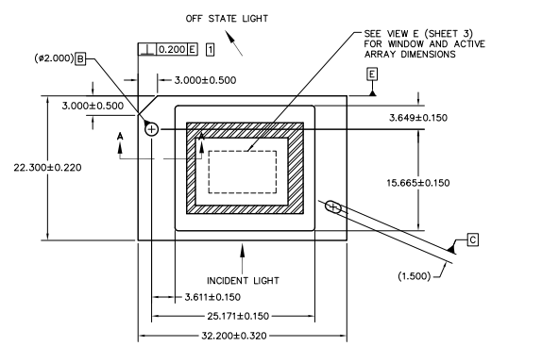
Corner vs. Bottom Illumination
Example: DLP650NE (VSP pixel)
Example: DLP480RE (TRP pixel)

Slide 17
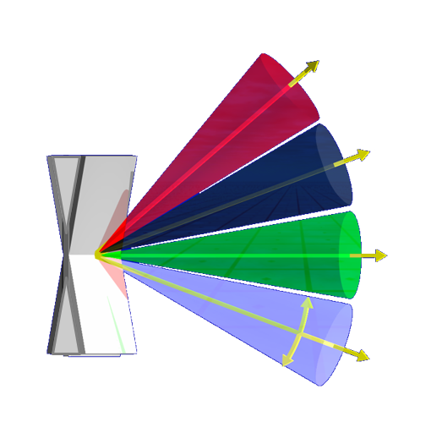
DMD Pupil Steering
Example: 12° Torsional Manhattan Oriented Pixel
Angular size of on state is the F/#
F/# = 1/(2*sin(θ))
Example:
12.0 degrees = F/2.4
14.5 degrees = F/2.0
17.0 degrees = F/1.7
Illumination
Direction of incident light
Projection lens stop
(f/2.4)
On
Flat
DMD active mirror array
24°
Off
24°
“On”
State
(+12°)
Manhattan DMD mirror array in package
Direction of off state
24°
“Off”
State
(-12°)
On state is limited by a physical aperture in the projection lens (STOP)
*DMD mirror does not have a flat state. Flat state is referred to as flat optical surface Fresnel reflections (i.e. DMD window, prism, etc.) that may enter the projection pupil and impact system contrast.
Notes:
Some terminologies: as you know DMD is a bi-stable device. We refer to the illumination , ON state and OFF state cone angle with respect to normal to the plane of DMD. Typically, for a 12 deg device, we use 24 deg angle of incidence.

Slide 18
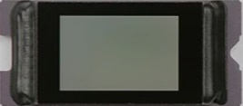
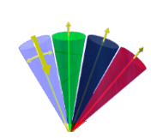
DMD Pupil Steering
Example: 12° Torsional Diamond Oriented Pixel
ILL
ON
FLAT
Side illuminated Cantilever Pixel Pupil Diagrams
OFF
Angular size of on state is the F/#
F/# = 1/(2*sin(θ))
Example:
12.0 degrees = F/2.4
14.5 degrees = F/2.0
17.0 degrees = F/1.7
Projection lens stop
(f/2.4)
Illumination
On-state
Flat-state
Off-state
Direction of incident light
DMD active mirror array
Direction of off state
24°
24°
24°
On-state pupil is limited by a physical aperture in the projection lens (STOP)
*DMD mirror does not have a flat state. Flat state is referred to as flat optical surface Fresnel reflections (i.e. DMD window, prism, etc.) that may enter the projection pupil and impact system contrast.
“On” State
(+12°)
“Off” State
(-12°)
Notes:
Some terminologies: as you know DMD is a bi-stable device. We refer to the illumination , ON state and OFF state cone angle with respect to normal to the plane of DMD. Typically, for a 12 deg device, we use 24 deg angle of incidence.

Slide 19
Pupil locations for Pixel Architectures
Torsional – Corner Illuminated
Cantilever – Bottom Illuminated
Incoming Light
Tilt
Roll
Off-State Light
Compound
Hinge Axis
Incoming Light
Hinge Axis
Off-State Light
OFF
FLAT
ON
FLAT
Pupil Diagrams
Pupil Diagrams
ON
OFF
Limited to symmetric f/2.4 (for 12° pixel) or F/2.0 (for 14.5° pixel) max due to flat state overlap
  Overdrive possible at expense of contrast loss.
24° illumination angle; 12° pixel tilt angle
29° illumination angle; 14.5° pixel tilt angle
Symmetric Expansion up to f/1.7 = 2X etendue vs. f/2.4
  Overdrive possible at expense of contrast loss
    not recommend faster than F/1.5
34° degree illumination angle; 17° pixel tilt angle

Slide 20
Matching Source Etendue with DMD
Source Etendue<DMD
Source Etendue=DMD
Source Etendue>DMD
Small etendue sources (i.e. laser)
System capable of high contrast
Matched source and DMD Etendue
Some separation between illumination and projection
Best tradeoff between brightness and contrast (usually)
Large Etendue sources (i.e. high brightness LEDs)
Can increase illumination angle to prevent interference with projection pupil
“Overdrive” condition allows illum & proj pupil overlap
Increase brightness at expense of reducing contrast
Apertures recommended to block flat state light
Prisms may often vignette portions of these pupils
Onstate (projection pupil)
Onstate (projection pupil)
Illumination
Flat-state
Illumination
Flat-state
Onstate (projection pupil)
Illumi
nation
Flat-state
Overlap region
Cone angle
≤ 2x tilt angle
Cone angle
= 2x tilt angle
Cone angle
≥ 2x tilt angle
DMD window
DMD mirrors (on-state)

Slide 21

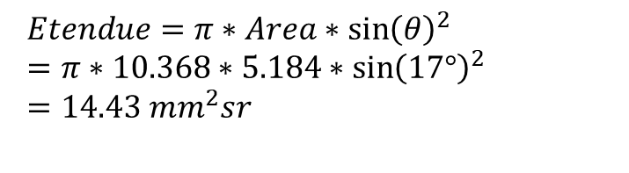
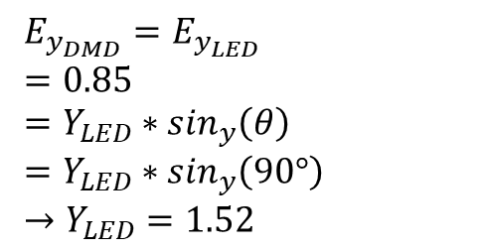
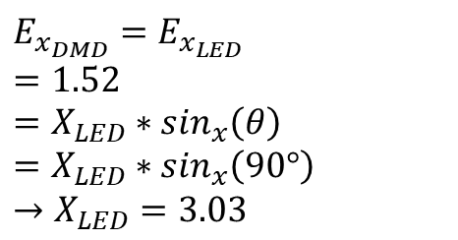

LED matching to DMD Example
0.47” TRP DMD
  10.368mm x 5.184mm
  17° Mirror Tilt
$$Etendue=π∗Area∗{\sin\left(θ\right)}^{2} =π∗10.368∗5.184∗{\sin\left(17°\right)}^{2}=14.43{ mm}^{2}sr$$
Break up Etendue in X and Y dimensions (“optical invariant”)
DMD
LED (Lambertian ±90° emission)
$$E_{x_{DMD}}=X_{DMD}∗\sin_{x}\left(θ\right) =10.368∗\sin_{x}\left(17°\right) =3.03$$
$$E_{y_{DMD}}=Y_{DMD}∗\sin_{y}\left(θ\right) =5.184∗\sin_{y}\left(17°\right) =1.52$$
$$E_{x_{DMD}}=E_{x_{LED}} =1.52=X_{LED}∗\sin_{x}\left(θ\right) =X_{LED}∗\sin_{x}\left(90°\right) →X_{LED}=3.03$$
$$E_{y_{DMD}}=E_{y_{LED}} =0.85=Y_{LED}∗\sin_{y}\left(θ\right) =Y_{LED}∗\sin_{y}\left(90°\right) →Y_{LED}=1.52$$
Note: overfill & anamorphism not included in these example calculations

Slide 22
DMD Efficiency
Example: 7.6μm pixel with f/2.4 optics
Efficiency_{DMD} = transmission_{window} × reflectivity_{mirror} × efficiency_{diffraction} × efficiency_{fillfactor}
Where
transmission_{window} is window transmission including four anti-reflection surfaces
reflectivity_{mirror} is the mirror reflectivity
efficiency_{diffraction} is the mirror array photopic diffraction efficiency into a given F/#
efficiency_{fillfactor} is the fractional mirror coverage (on-state mirrors) projected in the direction of the illumination
It should be noted that the first three factors depend on wavelength so more accurate results are obtained by calculating efficiency as a function of color and f/#
DMD efficiency = 0.96 × 0.89 × 0.84 × 0.93 = 0.67
For more information, refer to application note “DMD Optical Efficiency for Visible Wavelengths” https://www.ti.com/lit/pdf/dlpa083

Slide 23
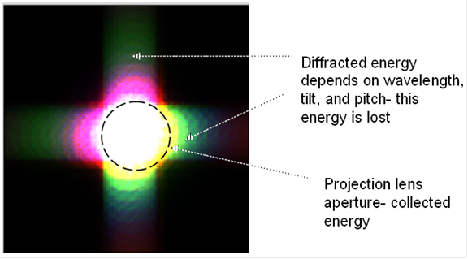
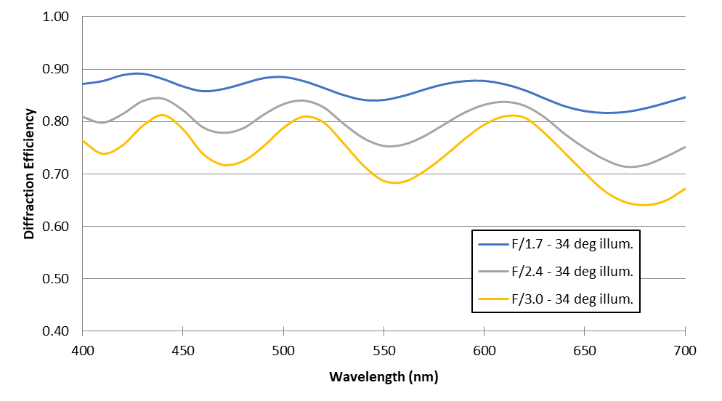
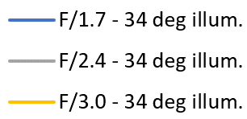
What is Diffraction Efficiency?
DMD diffracted energy is reflected scattered light due to the periodic structure of the DMD micromirror array – similar to a grating
Diffraction efficiency is a measure of the amount of light in the ON-STATE that enters the projection lens aperture (F/#)
Higher order energy is scattered beyond the projection lens aperture and lost
Typical RGB light source wavelength peaks
5.4μm Pitch DMD Mirror Calculated Diffraction Efficiency

Slide 24
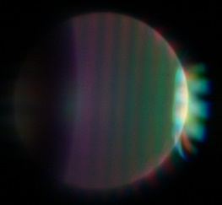
DMD (system) Contrast
Limited by collection of diffracted light into projection lens entrance pupil
Strong linear relationship in system F/# for matched illumination and projection lens pupils
Contrast generally increases with illumination angle
Contrast decreases with increased stray light in projection path
This is bad!
Pixel Orientation
No light enters projection pupil for good contrast
On-state pupil with DMD in on-state (exaggerated)
On-state pupil with DMD in off-state (exaggerated)

Slide 25
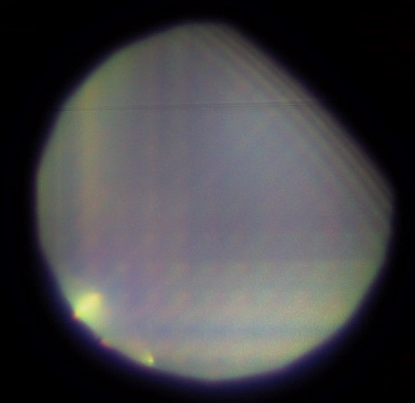
Additional DMD (system) Contrast Notes
Contrast is limited by scatter from the mirror array (previous slide)
Projection system F/# affects contrast (higher is better)
  Higher F/# increases contrast (but lets less light through)
  Must match illumination and projection lens f/# to achieve maximum contrast
Illumination incidence angle affects contrast
  Higher incidence angle (> 2x Pixel Tilt) increases contrast but lowers light throughput
Flat state light entering the projection lens pupil will significantly degrade contrast
Good control of stray light is needed to maximize contrast (see stray light mitigation section)
  Examples: Lens edge blackening / baffles and masks / off state control
Bad
Good
Example of OFF STATE projection pupil image filled with scattered light
Flat state light entering projection lens pupil

Slide 26
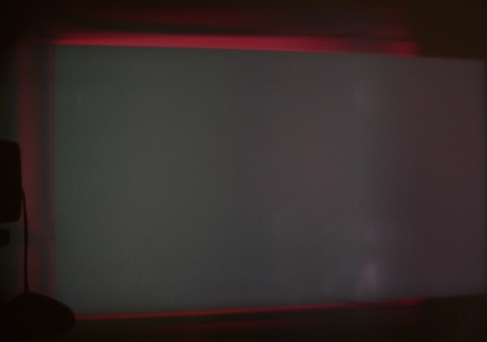
Flat State Light
Projection lens
TIR Prism
Light from the illumination beam reflecting from any flat surface between the DMD and the projection lens
Prism faces, the DMD coverglass or the flat surface outside of mirror array contribute to flat state light
Reflections from the coverglass or prism faces that are directly above the mirror array cause lower contrast if allowed to pass through the projection lens
Reflections from outside of the mirror array create a magenta border (if this is seen, there is flat state light entering the projection lens lowering system contrast)
Flat state reflections (red)
Illumination
DMD coverglass
DMD mirror plane
DMD active mirror array
Magenta border in off state projected image caused by flat state light entering projection lens pupil
(DMD mirror array is grey)

Slide 27
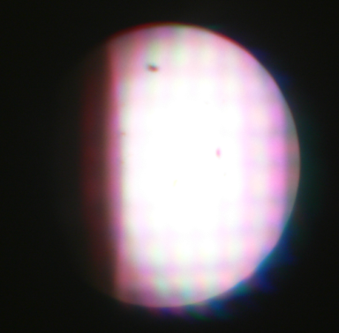
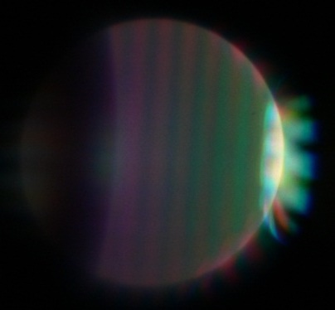
“The Magic Eye” Technique
A simple method for examining the exit pupil of a projector
  Mount a lens in front of the projection lens
  Image the stop of the projection lens to a screen
Shows where light is leaking through the pupil when mirrors are off
To improve contrast, add system apertures to block unwanted light
On State Pupil
Off State Pupil
Projection lens stop
Lens
Stop image on screen
DMD
Positive, longer focal length lens typically works best

Slide 28
Projection Architectures and Design

Slide 29
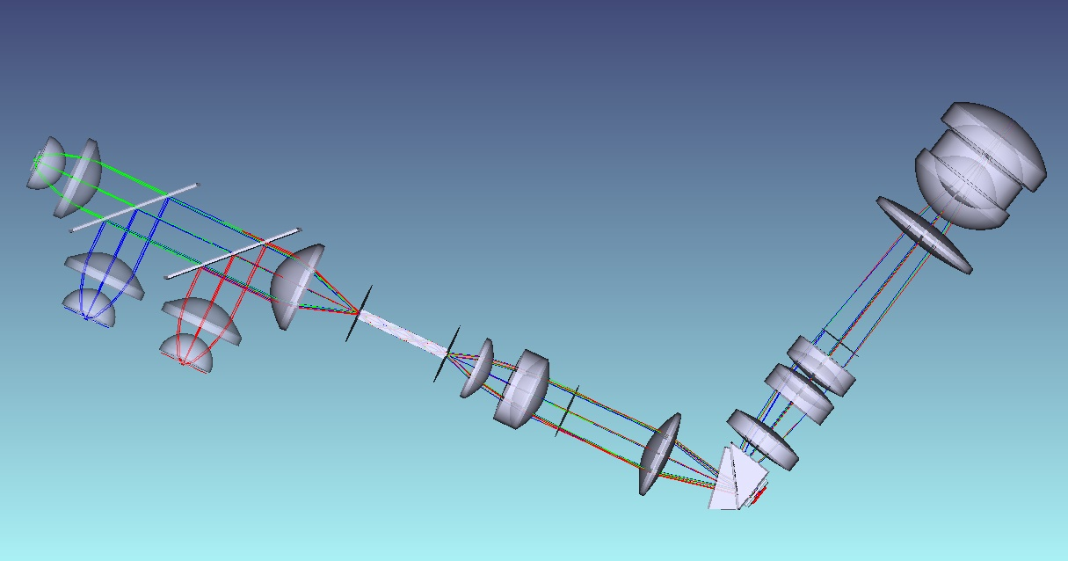
Projector System Layout & Design Options
There are many options for designing a DLP projector
Goal is to select the best configuration for the application:
  Illumination source (and system F/#)
    LED, laser phosphor, or direct RGB laser
  Illumination architecture (main interface optic)
    RTIR prism, TIR prism, Field lens, prism free (non-telecentric)
  Light mixing optic (aka light integrator or homogenizer)
    Tunnel or fly’s eye array
  Projection lens
    Throw ratio, zoom, image offset (lens shift), MTF, etc.
Projection Lens
Light mixing optic
Interface optic
(RTIR prism shown)
Illuminator
(3channel LED example shown)
Illumination Optics
DMD
Basic parts of a single chip DLP projector

Slide 30
Four Basic DLP Projector Architectures
#1
TIR Prism
#2
RTIR Prism
Projection
Illumination
Projection
Illumination
Small air gap (~5-10microns)
Upper wedge (optional)
DMD
DMD
#3
Field Lens
#4
Prism Free (non-telecentric)
DMD
Projection
Projection
DMD
Illumination
Illumination

Slide 31
Light source Illuminator System Design

Slide 32
Projector Illumination Sources
LED
“Laser”
1-channel
(RGB-in-1)
2-channel
(RB +G)
3-channel (R+B+G)
4-channel (R+B+G+dB)
(top side pump)
5-channel (R+G+B+dB+dR) (hyper Red)
Laser Phosphor
(Blue Laser +…)
Direct RGB Laser
(“Triple Laser”)
Single Wheel
Dual Wheel
Multi Segment Phosphor Wheel
Lamp
Hybrids
LED + Laser
(red boost)
LaPh + Laser
LaPh + LED
LaPh + Laser + LED
Static Yellow Phosphor + Color Filter Wheel
Yellow Phosphor Wheel + Color Wheel
R + B
Laser Assist
R+G+B
Laser Assist
Xenon
Metal Halide
Halogen
UHP
RGB-in-1
Laser Module
G/B + R
Laser modules
R + G + B
Laser modules
‘White’ Phosphor + Color Filter Wheel
Phosphor + Color Filter Wheel
Obsolete
Appo
ALPD 2.0
Appo ALPD 5.0
Casio/ Appo ALPD 3.0
Appo ALPD 4.0
Most Common LaPh
(Appo ALPD 1.0, Coretronic, Qisda, etc.)
Most Common LaserTV
(Nichia NUMM34/37 laser modules)

Slide 33
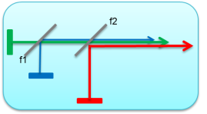
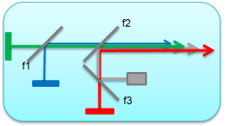
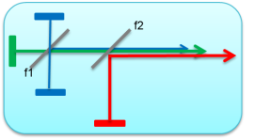
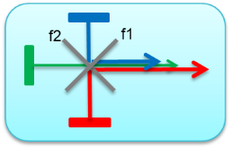
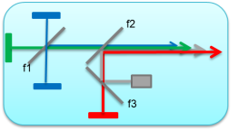
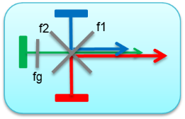
Illuminator: LED layout options
RGB
(3 channel)
High Efficiency
(4 Channel)
Compact
(3 Channel)
RGBB – Top Side Pump
(4 channel)
Long Wavelength Red Assist
(5 channel)
P3 (wide) Color Gamut
(3 Channel)
For more information on LEDs, refer to application brief “ LED Guide for Mainstream Projectors” https://www.ti.com/lit/pdf/DLPA130

Slide 34
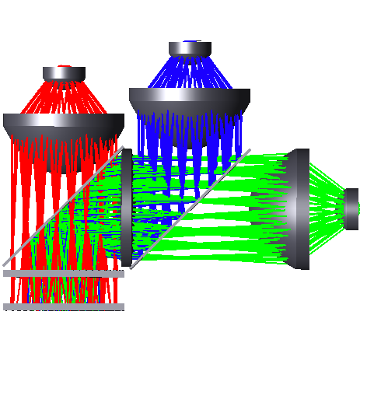
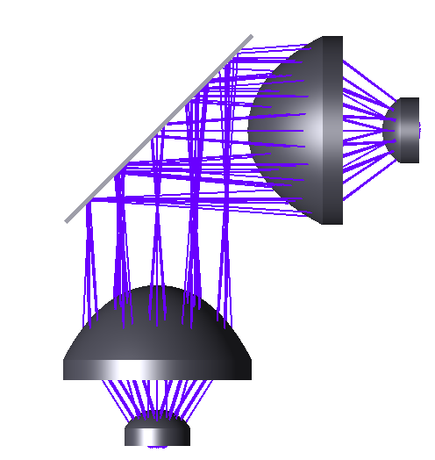
Illuminator: LED layout
4 channel using fly’s eye example
Green LED
Deep Blue LED
(For top-side green phosphor pumping)
Blue LED
Optional Corrector lens
To Illumination Relay
Red LED
Collimating Lenses
Dichroic filter
Fly’s eye Array (2 plates)

Slide 35
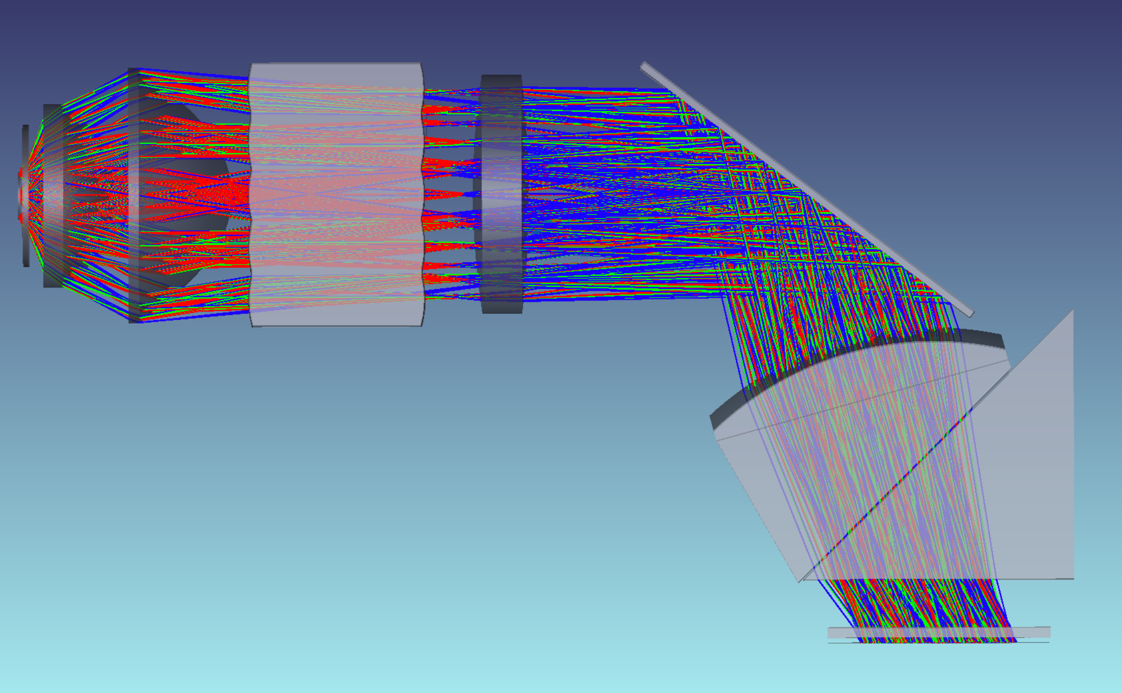
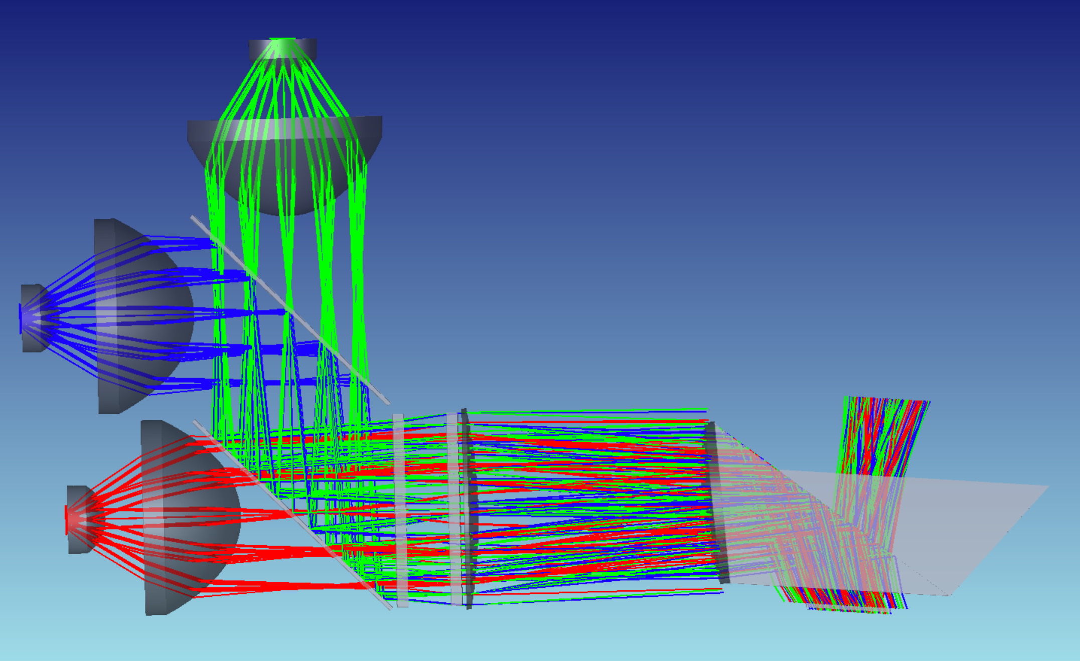
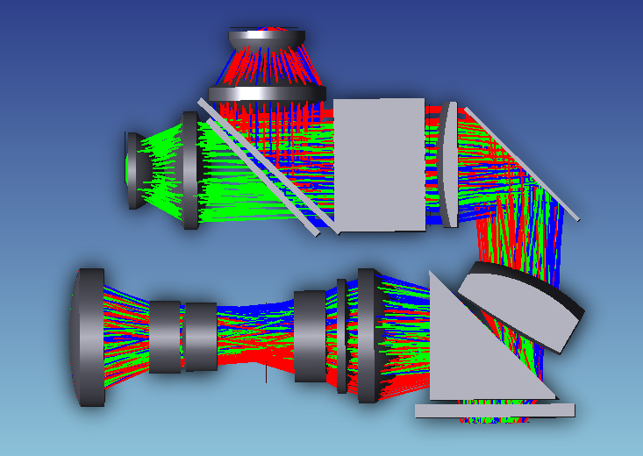
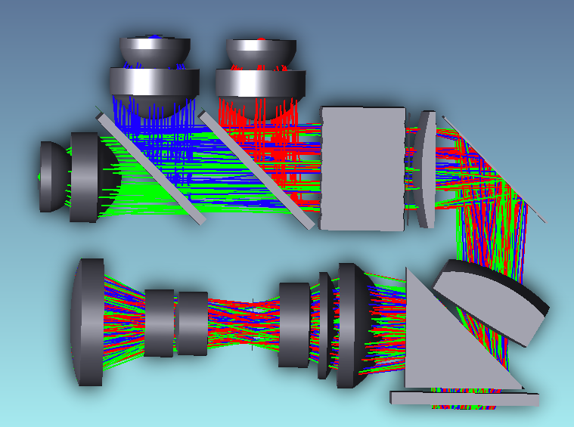
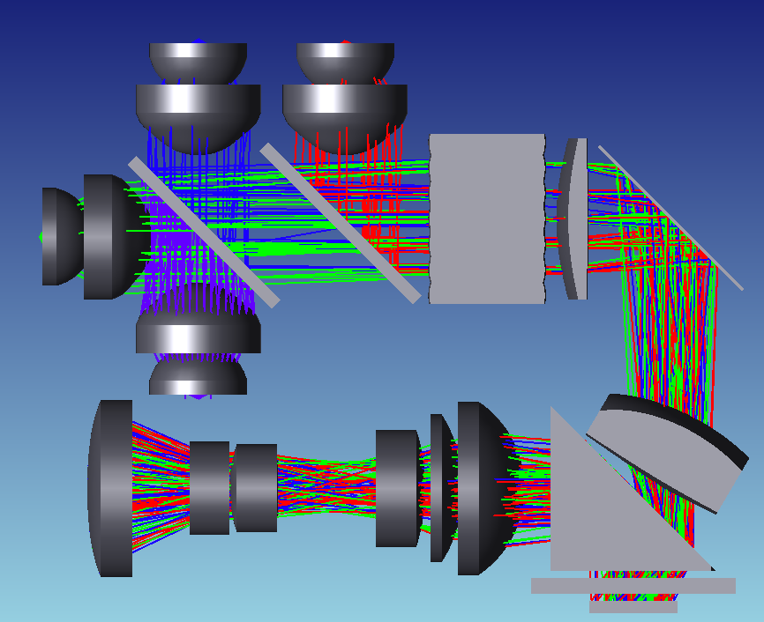
Common DLP LED optical architectures
1-channel
3-channel
RTIR w/wedge
LED illuminator
Fly’s Eye
TIR prism assembly
DMD
2-channel
LED illuminator
3-channel
4-channel
LED illuminator
Fly’s Eye
Fly’s Eye
LED illuminator
Fly’s Eye
Fan Dichroic or Dichroic Wedge
Dichroics
Dichroics
Deep blue pump LED
P-Lens
DMD
P-Lens
Similar fan-dichroic possible on 3-in-1 RGB LED
DMD
P-Lens
DMD

Slide 36
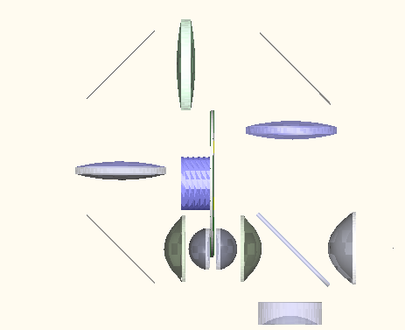

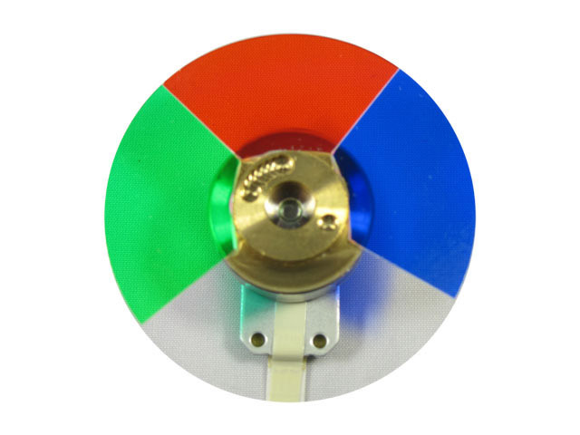
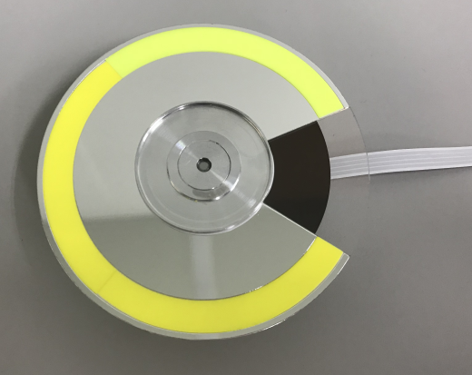
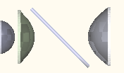


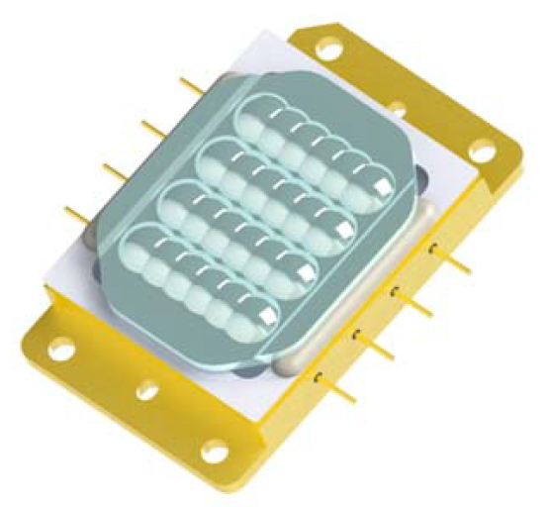
Illuminator: Laser Phosphor
Performance products brightness levels
Traditional layout
Compact layout (eliminating blue wrap path)
Blue wrap path
Optional blue path diffuser
Reflective
phosphor wheel
Reflective
phosphor wheel
Blue reflective
dichroic mirror
Blue
dichroic
Condenser lens
Tunnel
Focusing/ collecting optics
Color filter wheel
Tunnel
Beam reducing optics
Beam steering mirror
Color filter wheel
Laser beam spot diffuser/shaper (i.e. lens array)
Beam reducing optics
Laser spot on phosphor
Blue laser module
Laser beam spot diffuser/shaper (i.e. lens array)
Blue laser module
Other “hybrid” architectures where adding a separate green and/or red channel using LED or Laser are possible to improve color gamut or system efficiency.

Slide 37
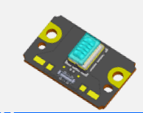












Blue Lasers for Laser Phosphor
MSW LaPh architectures
(single wheel, fly’s eye)
Reflective Transmissive
Blue laser module (<1KLm)
Blue laser module (~2-3KLm)
Multi Segment Phosphor Wheel (RGBY)
Multi Segment Phosphor Wheel (RGBY)
Blue laser module (~3-4KLm)
Blue laser module (~4KLm+)
G
B
G
B
Y
R
Y
R
Split
dichroic
Fly’s eye
Fly’s eye
Most Common LaPh Architecture
Dual wheel, tunnel based
To DMD
Blue mirror
Blue reflective segment
Laser beam spot diffuser/shaper (i.e. lens array)
To DMD
Focusing/ collecting optics
Collecting Optics (collimators)
Reflective
phosphor wheel
For hybrid LED or laser source here
Color filter wheel (primary and/or secondary colors)
Laser beam spot diffuser/shaper (i.e. lens array)
Blue laser module
Blue laser module
Yellow
dichroic
Static Phosphor Architecture
Single wheel, tunnel based
Condenser lens
Tunnel
Blue reflective segment
Reflective static phosphor
For hybrid LED or laser source here
Color filter wheel (primary and/or secondary colors)
Focusing/ collecting optics
(collimators)
Blue dichroic
Beam reducing optics (optional)
Yellow
dichroic
Laser beam spot diffuser/shaper (i.e. lens array)
Condenser lens
Tunnel
Focusing/ collecting optics
(collimators)
Blue dichroic
High Brightness Blue laser module (4KLm+)
Laser beam spot diffuser/shaper (i.e. lens array)
Blue laser module

Slide 38


Collimator design example for LED and LaPh
Typically designed for ideal LED size, matched to DMD for maximum efficiency
  Don’t forget to include LED coverglass if included with LED. Efficiency is sensitive to LED collimator focus/alignment
LED collection half angle of ±70° to ±80° out of Lambertian ±90°
  Smaller collection angle results in easier design and manufacturability while trading off efficiency
Optimize for a specific focal length or illumination pupil size (‘angular radius’ in Zemax)
  Focal length and pupil size must be Etendue compatible with rest of the system (i.e. fly’s eye array, relay optics, DMD) for maximum efficiency
S-LAH53
(n_{d}=1.806)
Polycarbonate or B270 moldable glass
Recommend less than 65° AOI on this surface due to coating transmission limitation
LED
High index allows better shape for manufacturing and clearance to LED. Watch out for blue absorption.
Space for dichroic
Asphere (Can be both sides. (Watch out for inflection points)

Slide 39






LED/Phosphor to Fly’s Eye Array (FEA) / Tunnel
Tunnel-based
FEA-based
LED/ Phosphor
LED
Pre-Collimator
(High index glass)
Tunnel Input
Typically designed for ~F/1 input. ±26°-30° optimized for good homogenization at a reasonable tunnel length
Pre-Collimator
(High index glass)
Collimator
(Asphere)
Condenser (Asphere)
Collimator
(Asphere)
Dichroic
FEA Input
Must be collimated light
Collimated Space :
Diameter is dependent on Etendue which tell you size of dichroic needed (leave enough distance between lenses for filter)
Color filter wheel location (LaPh architecture)

Slide 40

Illuminator: RGB Laser layout example
projection
Condenser lens
Illumination aperture
dichroic
mirror
light tunnel
DMD
Illumination relay optics
3in1 RGB Laser module
High angle diffuser (typ. moving for despeckle) – expands light cone (F/#)
Low angle diffuser (static or moving for despeckle) – increases spot into tunnel
Other variations using a fly’s eye also possible (see slide 42)

Slide 41





Calculating Etendue of Laser
Must calculate for the specific laser being considered. Area and divergence may vary from example below, refer laser datasheet.
Similar to LED, you can calculate the optical invariant of lasers in x and y
Red laser example
X
Beam divergence
$$E_{x}$$
$$=X∗\sin\left(θ_{x}\right)$$
$$=24mm∗\sin\left(2.5°\right)$$
$$=1.047$$
$$E_{y}$$
$$=X∗\sin\left(θ_{x}\right)$$
$$=16.3mm∗\sin\left(0°\right)$$
$$=0$$
Y
θ_{x}
(slow axis divergence after collimation)
Assuming perfect collimation, laser is etendue free in y-axis!
Beam footprint area
θ_{y}
(fast axis divergence after collimation)
Now let’s add a 5° diffuser for despeckle…
$$E_{x}$$
$$=X∗\sin\left(θ_{x}\right)$$
$$=24mm∗\sin\left(\sqrt{{2.5°}^{2}+{5°}^{2}}\right)$$
$$=2.338$$
$$E_{y}$$
$$=X∗\sin\left(θ_{x}\right)$$
$$=16.3mm∗\sin\left(5°\right)$$
$$=1.421$$
Based on 0.39 DMD (w/ 15% overfill) Etendue calculations, you would collect ~87% in x and ~93% in y, so only ~81% collection efficiency for this laser + diffuser example.

Slide 42

Laser Speckle
High coherence of laser light causes speckle noise
  Spatial coherence = small etendue
  Temporal coherence = narrow spectrum
Objective speckle = image intensity fluctuations (noise)
  Relatively easy to mitigate with diffusers, etc.
Subjective speckle- changes with head movement
  Very difficult to mitigate
  Limited by system (DMD) etendue
  Longer wavelength → larger grain structure easier to see
  High-gain screens exacerbate problem

Slide 43






Methods for Reducing Laser Speckle
Wavelength diversity
  Multiple diodes with slightly different wavelengths
  Dual or triple wavelength red: 638nm + 642nm for example
  Multiple diodes helps due to tolerances widening the wavelength bandwidth
Spatial and angular beam diversity
  Beam shaping using static diffusers for better homogenization
  Temporal diversity: moving diffusers to randomize phase
Polarization diversity
  Multiple laser paths with rotated polarization – circular vs. linear polarization
  Adding a waveplate for polarization scrambling
Laser current modulation (square, triangular, sawtooth & other waveforms)
  More impactful for single diode systems
https://www.optotune.com/laser-speckle-reducers
Yilmazlar, I., and M. Sabuncu. "Implementation of a current drive modulator for effective speckle suppression in a laser projection system." IEEE Photonics Journal 7.5 (2015): 1-6.

Slide 44
Common Laser Architectures w/ despeckling
Static Diffuser – expands spot size at tunnel (spatial diversity)
Optional static diffuser – helps homogenize light within pupil
In addition to spectral and polarization, speckle is mainly a function of Etendue as shown in simulations.
Slower F/# optics result in higher speckle contrast.
It is important to maximize the laser Etendue as uniformly as possible. (see next slide for example)
  Fill up illumination pupil with laser light thru diffusion methods
    Moving diffuser is best (Optotune, diffuser wheel)
    Stationary diffusers to expand spot size
    Rectangular and uniform diffusers better than circular Gaussian
Moving diffuser – expands light within pupil (angular diversity)
Common illumination despeckling layout:
θ
Light Tunnel
To DMD
Static Diffuser – spatial diversity, necessary?
Focusing lens
Fly’s eye array
Moving diffuser –fills up the pupil for angular diversity
Moving diffuser –angular diversity
Collimator
Fly’s eye array
θ
To DMD
To DMD
This architecture has limitations:
Large moving diffuser required (clear aperture)
  Cannot use wheel
Limit on pupil size and/or F/#
May need higher density fly’s eye array for spatial diversity

Slide 45

Typical illuminator design process for speckle reduction
Expand spot size and fill up pupil uniformly
Spot @ Tunnel
(1° static diffuser)
F/2.4 Illum. Pupil
(no angular diffusion)
w/ 1.5° stationary diversity diffuser
Note: Angles don’t change
5° diffuser wheel
+
5° static diffuser after tunnel
5° diffuser wheel
+
10° static diffuser after tunnel
5° diffuser wheel only
0.9% loss
w/ 2.0° stationary diversity diffuser
Note: Angles don’t change
0.6% loss
3.6% loss
1.3% loss
45
2.6% loss
(Blue & Green not shown)
Note: These angles vary based on design (shown as example only). Gaussian diffusers (FWHM) examples.
Modeled using Zemax non-sequential.

Slide 46
Illumination Relay Design

Slide 47


Light Mixing Options
Illumination optics must illuminate the DMD uniformly for a uniform projected image
Two methods commonly used to mix/homogenize light: Fly’s eye array and Light tunnel
Light Tunnel
Fly’s eye array
Non-uniform focused beam input
Uniform output
Uniform output
Non-uniform collimated beam input

Slide 48


Light Mixing Options
Examples:
Light tunnel
Fly’s eye array
Hollow light tunnels
Highly reflective interior walls
Tapered or straight
Can be solid glass rods for high brightness
Glass or plastic
Single double sided piece or two piece plates
www.materion.com/products
http://www.isuzuglass.com/products/

Slide 49


Light Tunnel vs. Fly’s Eye Array Relay Optics
Tunnel
  Typically required for systems that use a color wheel (i.e. lamp, laser phosphor) or lasers with specific despeckling requirements
  Much larger in overall length than FEA design
  Lowest stray light and easiest for design and alignment
  Recommend hollow tunnel to avoid dust, scratches on ends of tunnel. Solid fused silica rods may be necessary for very high lumen projection systems.
  Disadvantage: Longer illumination optics
Fly’s Eye Array
  Most common with LED-based illuminators but can be used with laser systems also (no color wheel)
  More compact with less elements
  Generally does not require aspheric optics
System apertures recommended for stray light from FEA cell crosstalk or light tunneling at edges of tunnel (see next slide)
Note: designs shown are for comparison only
FEA
FEA
Tunnel
Hollow light tunnel minimum length ~ 30-35mm (always check uniformity with raytrace)

Slide 50

Crosstalk and Tunneling in FEA and Tunnel
Hollow light tunnel may have light tunneling in walls
Lens array crosstalk will lead to multiple illuminated areas on DMD
Mitigation options:
  Aperture or blacken tunnel wall faces (paint on output / metal mask on input)
  Design FEA for minimal crosstalk
  Paint aperture on DMD side of prism to mask off unwanted FEA crosstalk
  Mechanical baffles
FEA Illumination
Crosstalk image
Light tunnel output
Desired light from inside tunnel
Desired illumination
Crosstalk image
Crosstalk image
Desired DMD illumination
Light trapped and guided in the glass walls of the tunnel overfill DMD with unwanted light (mask this off)
Crosstalk images only contribute to stray light

Slide 51


TIR and RTIR Prism architectures
Used to separate illumination and projection light bundles
Traditional TIR
Reverse TIR
Air gap (~ 7-10um)
Incoming illumination
Projection lens
DMD
Projection lens
Air gap (~ 100-200um)
Incoming illumination
DMD
Project through air gap
Tightly control air gap to reduce aberrations (typically <0.01mm)
Illuminate through air gap
Air gap not as critical (typically <0.2mm)

Slide 52




Prism Material Selection
Critical for RTIR only. TIR prism are typically N-BK7 or equivalent for cost
Depending on F/# of system, prism material index must be selected to meet TIR condition at all fields at 45° prism interface
F/2.4 (Bottom Illumination)
Prism refractive index, n_{d}=1.5
75.7% TIR
Lost light (from TIR failure)
F/2.4 (Bottom Illumination)
Prism refractive index, n_{d}=1.65
100% TIR
No light loss
DMD
DMD

Slide 53

Bottom vs side vs diagonal illumination

Slide 54

Relay Design Example (tunnel-based)
Angled 90°+ to allow off-state light to escape prism
Typical Tunnel to DMD relay
(Bottom Illumination shown)
Design angle to meet TIR condition for all fields + some tolerance
DMD
Thickness of 2nd prism enough to clear on-state bundle
Tunnel output (x & y dimensions + light cone F/#) matches input if straight tunnel. Typical input cone ±26°-30°. If tapered, must calculate cone angle based on Etendue conservation.
TIR prism can be low index (N-BK7)
Typically Aspheres
Lens may need to be truncated if interfering with DMD package
Illuminator input
Tunnel
Illumination aperture
Fold mirror (optional)
Optional doublet for color correction in illumination

Slide 55

Relay Design Example (Fly’s eye array - based)
Relay lenses
2-3 lens typical
Aspheres optional
Fly’s eye array (FEA) can be either 2 independent pieces or a single molded part
TIR Bottom Prism shown
Optional space for fold
DMD
Optional space for fold
Fly’s eye plates
Lens can be cemented to TIR prism input surface to reduce number of AR coated interfaces

Slide 56



Fly’s Eye Array Design Method / Tips
FEA can be separate plates or 1 monolithic molded element
Glass recommended in high brightness applications due to flux density. Polycarbonate may be okay at lower lumen levels.
Illumination pupil size determined by system Etendue and collimator design (focal length)
Pupil Sampling: 10-12 lens array cells minimum along long dimension for good homogenization and DMD uniformity
Once cell size is determined, focal length can be calculated based on LED to FEA or FEA to DMD magnification
  Design FEA based on focal length
  Edge Thickness or form depends on manufacturing capability

Slide 57



FEA-based Relay Design Method / Tips
Easiest design method uses a multi-configuration of several lens array cells sampling the illumination pupil
  Shift in X and Y after the FEA and design relay system
Field Size set to lens array cell dimension, “Aperture” set to pupil diameter of each cell (y-height)
2 Lens relay typical
  Aspheres not necessary but do help with some aberration control
Pupil diameter set based on system Etendue and parameter calculations (matched with collimator pupil)
Relay Lenses
Wedge prism can be low index, angle varied to compensate for anamorphism / distortion of illumination overfill
DMD
(optional space for fold)
RTIR
prism

Slide 58



Field Lens Architecture
Projection lens
Can be used with light tunnel or FEA
Field lens is shared between illumination and projection lens, placed directly in front of DMD
Field lens separates illumination and projection light bundles without the need of a prism
Projection lens tends to be smaller
Telecentricity can be maintained
NOTE: Specular reflections from illumination light incident on field lens surfaces may create a stray light reflection on the screen resulting in lower contrast
  Highly dependent on shape (curvature) of field lens
  If considering a field lens architecture, evaluate stray light reflections created from illumination light incident on field lens surfaces
DMD
Field Lens
Relay optics
Tunnel
On State Light
Field Lens Ghosting
(mirrors in off state)
Relative Power:
100%
0.52%

Slide 59



Non-telecentric illumination considerations
DMD assembly
Corner-Manhattan illumination shown
Bottom illumination shown (TRP)
Typically aspheres
Tunnel output
Typical 3 lens tunnel to DMD relay design
Fold mirror
Schiempflug (tilt) can be added to improve distortion and/or anamorphism of tunnel to DMD relay
Last illumination lens typically cut to give space for projection lens (this will incur some efficiency loss)

Slide 60


Non-telecentric pupil matching
Non-telecentric systems require illumination exit pupil to match projection entrance pupil (from DMD side) in size and position for maximum system efficiency
For 0.65” 1080p, projection lens pupil is typically 30-40mm from DMD
  Further pupils, chief ray angles become closer to telecentric
  Closer pupils, chief ray angles become steep on DMD → more difficult to correct anamorphism, distortion without using a prism (DMD recommended to have a 55° max ray angle)
Offset must be considered for non-telecentric
  Needed to separate illumination and on-state light bundles
  A minimum of 100% image offset is typically required
Calculation on right assumes the following:
  0.65” 1080p s450 (14.592mm x 8.208mm)
  Corner illumination – 45° rotation w.r.t. DMD array
  12° mirror tilt
  130% vertical image offset only
  40mm pupil location
Sample calculation:
DMD
1st Lens/Pupil location (40mm from DMD)
5.34mm
θ_{y}
θ_{z}
DMD optical axis
θ_{x}
Lens optical axis (due to offset)
Incoming illumination center chief ray
$$θ_{z}=45° due to corner illumination$$
$$Illumination angle= 2 × mirror tilt + θ_{y}=2×12°+7.6°=31.6°$$
5.34mm
θ_{y}=7.6°
40mm

Slide 61



Non-telecentric Relay Design Method / Tips
Constrain pupil position to match projection pupil
  Can use EXPP operand in Zemax (more accurate for paraxial system not real systems)
  Set individual real ray coordinate operands to zero (chief rays are at 0,0 at pupil planes)
Constrain F/# using WFNO or through calculated pupil diameter using real ray coordinate operands
Constrain incident angle onto DMD based on 2x pixel tilt + offset angle to account for image offset (slide 51)
Illumination lenses can be off-axis (tilted or decentered relative to tunnel output face) to help correct for distortion / tilted focus plane – “Scheimpflug”
DMD
Simulated projection pupil at some finite distance
Pupil distance
Retroreflect back to DMD to allow for spatial and angular optimization at the same time
Accounts for DMD illumination angle
Tunnel output

Slide 62
Anamorphism in Illumination Optics
Anamorphism (unequal magnification in x and y) between the light mixing optic and DMD needs to be taken into account in the design
Anamorphism is caused by path of light in prisms (TIR and RTIR) and the oblique illumination angle of incidence
Typical numbers range from ~ 1.05 to 1.3 depending on system
  TIR prism has very low anamorphism (~1 to 1.1x typical)
  RTIR with upper wedge has low anamorphism (~1 to 1.1x typical)
  RTIR (right angle prism) has largest anamorphism (~ 1.3x typical)
Anamorphism results in loss of etendue (LED usable area is smaller)
Illumination
FEA cell / light tunnel aspect ratio
Illumination light aspect ratio on DMD
To projection lens
~ 1.3 X stretching from illumination to DMD surface
* Note: If bottom illuminated, stretching is in the vertical direction
DMD
(side Illuminated example)

Slide 63





Zemax Modeling Tip : Irradiance Analysis
To model the illumination profile including overfill on DMD, use “Geometric Image Analysis”.
  Other surfaces can also be analyzed
Source width
$$\frac{\text{Efficiency} \text{with} \text{obscuration}}{\text{Efficiency} \text{on} \text{DMD} \text{Plane}}$$
$=\text{Energy} \text{Overfill}$ %
IMA file simulates source size
Center field
Analyze at DMD surface
Add ‘rectangular obscuration’ aperture to simulate DMD illumination overfill
Sampling
LED is Lambertian

Slide 64



Zemax Modeling Tip: Far Field Analysis
Used to analyze F/# and pupil in telecentric systems
Circular obscuration to match F/# to determine how much light is lost
Add radius for solid angle (depending on distance set)
Set far-field distance
Illumination AOI (if analyzing DMD far-field)
Note: Circular obscuration radius= distance*sin(θ) where θ =half-angle

Slide 65
Projection Lens Considerations
For additional information, visit: https://training.ti.com/common-projection-lens-specifications

Slide 66
Telecentric vs. Non-telecentric
Prism air gap
Telecentric
Non-telecentric
Pupil at finite distance
(typically at rear of projection lens)
Pupil at infinity
Illumination angle constant across DMD
Illumination angle varies across DMD
Lens offset required to separate illumination and projection light
Lens must be pupil size and location matched to the illumination for maximum efficiency
  More difficult to interchange lenses
Lens shift not possible without sacrificing efficiency/brightness
Image uniformity not as good as telecentric designs
Lens is typically smaller and lower-cost
F/2 – F/2.4 maximum limits used to non-LED typically
Prism required to separate illumination and projection light paths
  Air gap functions as angular filter via total internal reflection (TIR)
Allows for interchangeable lenses
Lens shift possible in design
Image illumination uniformity is typically good
Lens can be big especially with low F/#

Slide 67
Trimming lenses in Prism Architectures
TIR and RTIR may need lenses trimmed to avoid mechanical interference with DMD package or electronics
May need to increase back working distance to minimize interference of DMD with projection lens and/or XPR actuator
Always check mechanical clearances in design and move or adjust optics accordingly
TIR PRISM
RTIR PRISM
Check clearance to projection lens
Projection
Illumination
Projection
Illumination
DMD Package / board
DMD Package / board
May need to trim lens (often times no need)
Often need to trim 1-2 lenses with RTIR with larger DMD packages

Slide 68



Typical Projection Lens Design Targets
Field Size: At minimum the field is the DMD size + image offset / lens shift (if any)
F/#: Matched to the Illumination (for contrast optimization) or higher if aperture is adjustable
MTF:
  As designed: Polychromatic (All wavelengths): ≥50% at Nyquist Frequency $\left(\frac{1}{2∗pixel size}\right)$
  Nyquist Frequencies:
    10.8µm pixel: 46 line pairs/mm
    9.0µm pixel: 56 line pairs/mm
    7.6µm pixel: 66 line pairs/mm
    5.4µm pixel: 93 line pairs/mm
Distortion: ≤1% (goal) <1.5% (acceptable). Other applications may allow more relaxed distortion.
  TV Distortion: ≤1%
Lateral Color: Between any two wavelengths target of ≤ ±0.5pixel and max of 0.75pixel at corners of field
Telecentric vs. Non-Telecentric
  Telecentric: Chief rays variation ≤0.5° preferred, ≤1.0° acceptable – this creates larger pupil and may introduce flat state light
  Non-Telecentric: pupil position must be matched to illumination otherwise system may experience contrast issues or light loss
Back focal/working distance: Must account for prism thickness and material (if applicable) as well as DMD window
  Add XPR glass plate if applicable
Image distortion
Lateral color

Slide 69

Throw ratio
Throw ratio quantifies the size of an image created when a projector is placed a given distance from the screen.
Small throw ratio systems can be placed closer to the screen and still create large images.
D
W
$$Throw ratio= \frac{\text{D}}{\text{W}}=\frac{distance from lens to image}{horizontal width of image}$$
Throw ratio > 2: “long throw”
Throw ratio 1-2: “standard throw”
Throw ratio < 1: “short throw” or “ST”
Throw ratio < 0.4: “ultra short throw” or “UST”
Notes:
Throw ratio describes the image size a projector creates when placed a set distance from a screen. To calculate the throw ratio of a projector you divide the distance between projector and screen by the width of the projected image. Systems with smaller throw ratios can create large images even when placed very close to the screen. Different projectors exhibit a wide variety of throw ratios, ranging from greater than 1, called long throw, all the way to less than 0.4, called ultra short throw.

Slide 70


Lens Offset
Offset is a shift of the projection lens relative to the center of the DMD
  This results in a corresponding displacement of the projected image.
Offset enables a projector sitting on a table or mounted to a ceiling to display a full image on the wall without any portion of the image being blocked by the nearby surface
Some projectors are designed with a fixed offset, while others offer adjustable offset by moving the projection lens.
Larger offsets necessitate an increase in the size and complexity of the projection lens.
0% Offset
100% Offset
Image
DMD
Projection Lens
Optical Axis
Projected image is centered on the lens, extending equally above and below the optical axis.
Projected image is entirely above the optical axis.
Notes:
Offset is a shift of the DMD position relative to the optical axis of the projection lens. This shift creates a corresponding displacement of the projected image. As depicted by the diagrams below, the projected image of a 0% offset system extends equally above and below the optical axis of the projection lens. In a system with 100% offset the projected image is entirely on one side of the optical axis.
Offset is most commonly used so that a projector mounted flat on a table or ceiling can still display a full image on the wall. Without any offset the table or ceiling would block half of the image. Some projectors are designed with a fixed amount of offset, while others can be adjusted by moving the projection lens. Designing a system to accommodate larger offsets increases the size and complexity of the projection lens.

Slide 71

Modulation Transfer Function (MTF)
The MTF is a measure of contrast reduction imposed by an imaging system (projection lens) as a function of spatial frequency in line-pairs/mm (lp/mm)
It is the standard metric to describe lens performance for resolution and contrast
The spatial frequency of a DMD is determined by the pixel pitch. One line pair = two pixels width
The highest spatial frequency that can be produced by a DMD or any spatial modulator is one pixel white + one pixel black. This is called the Nyquist frequency.
  10.8um pixel = 46 lp/mm
  9.0µm pixel = 56 lp/mm
  7.6um pixel = 66 lp/mm
  5.4um pixel = 93 lp/mm
Typical requirement for DLP projection lens is 50% MTF at Nyquist by design
  Some customers often may reduce design to 30-40% MTF to tradeoff performance for cost
  Must consider opto-mechanical tolerances will reduce MTF
    Production lenses are often ~20% MTF after tolerances

Slide 72


Example Projection Lens Designs
XPR location (if applicable)
Telecentric
DMD
To Image
Prism
XPR location (if applicable)
Non- Telecentric
DMD
To Image

Slide 73


Example Projection Lens Performance
Relative Illumination: >90% for telecentric lens
  No vignetting recommended
Non-telecentric has a natural roll-off
  >60% center to edge recommended
Polychromatic MTF: All fields >60%
(92lp/mm for 5.4um pixel)
Distortion: 0.5%
Lateral Color:
<0.5pixel

Slide 74
Resolution Enhancement
For additional information, refer to:
Sing, Molly N., et al. "Super resolution projection: leveraging the MEMS speed to double or quadruple the resolution." Emerging Digital Micromirror Device Based Systems and Applications XI. Vol. 10932. SPIE, 2019. https://doi.org/10.1117/12.2512005

Slide 75


What is Super Resolution?
Native DMD Resolution
(2716 x 1528)
Displayed Resolution
(3840 x 2160)
2-way actuator by Young Optics Inc.
4-way actuator by Optotune
Position A
Position B
Opto-electronic shifting of a DMD pixel using a tilting optical element (actuator) to create 2x or 4x the resolution within a single image frame
2-position actuator shift example above
4-position actuator shift available also
https://www.optotune.com/pixel-shifting
https://www.minaik.com.tw/

Slide 76




Actuator Optical Details
Transmissive tilted plate used for x & y tilt to displace the beam by ½ or ¼ pixel size
  Thickness & material will depend on actuator supplier which affects beam displacement
Actuator plate must be designed into the projection lens optical design
  placed between DMD and projection lens
Compatible with telecentric and non-telecentric optics
DMD
5.4µm
3.818
µm
RTIR
TIR
ACTUATOR

Slide 77
Colorimetry & System Lumens Budgeting

Slide 78


Radiometry & Photometry
A
Quantity | Radiometric | Photometric | Most useful
Flux | Watt | Lumen | Front projection
Irradiance or Illuminance | Watt/m² | Lumen/m² (Lux) | Front projection (light falling on screen)
Radiance or Luminance (brightness) | Watt/m²/ster. | Lumen/m^2/ster. (Nit) | Rear projection (perceived brightness)
r
W = A / r² (ster.)
Photopic curve
Lumen is a measurement of power weighted by
the photopic curve
Photopic (lumens)
weighted by eye response
Blue
source
Green
source
Red
source
blue
green
red

Slide 79




Colorimetry
CIE chromaticity diagram
CIE standard observer color matching functions
Corresponds to how the human visual system perceives colors
Used for color mixing
XYZ Tristimulus values can be
plotted for primaries such as red, green, blue, yellow, and white using chromaticity coordinates:
$$X= \int_{0}^{∞}{L\left(λ\right)\overline{x}\left(λ\right)dλ}$$
$$Y= \int_{0}^{∞}{L\left(λ\right)\overline{y}\left(λ\right)dλ}$$
$$Z= \int_{0}^{∞}{L\left(λ\right)\overline{z}\left(λ\right)dλ}$$
Where $L\left(λ\right)$ is the source spectrum
$x=\frac{X}{X+Y+Z}$
$y=\frac{Y}{X+Y+Z}$
$z=\frac{Z}{X+Y+Z}=1−x−y$
These help determine the color gamut achievable of the projector (see color gamut slide)

Slide 80
Typical Source Spectra L(λ)
LED
Laser Phosphor
Direct Laser

Slide 81


Color Gamut
Rec. 709 HD TV standard gamut
CIE 1931 chart represents normalized hue/saturation on a cartesian grid
Area within the gamut triangle (polygon) represents the set of all colors reproducible by the projector
Points closer to locus are more saturated or “pure” colors
Color temperature of “white point” is read from chart
  Lower color temperatures – red
  Higher color temperatures – blue
Laser projectors typically have the widest color gamut
Color | x | y
Red | 0.640 | 0.330
Green | 0.300 | 0.600
Blue | 0.150 | 0.060
D65 white | 0.313 | 0.329
Laser projector

Slide 82
Creating a Lumen Budget
A prediction for the projector lumen output can be made with basic knowledge of the optical parameters
Process for developing a lumen budget
  Determine the etendue of the DMD and projection optics and source
  Determine the fraction of source light sent to the DMD based on etendue (before optical design)
    Or for more accurate geometric efficiency, use results from optical design raytrace analysis
  Create a straw man transmission efficiency of the projector system
    Higher performance coatings will improve system efficiency
  Calculate the lumen output of the source (color balanced over temperature)
    Straightforward with LED or laser
    Laser phosphor requires understanding phosphor conversion and flux density/ thermal quenching as well as spot size blooming (Etendue impact)
  Combine source output and system transmission for projector lumens estimate

Slide 83
Lumens Budget Example for LED-based system
Note: This starting straw man lumen budget assumes R,G and B all are equal in system transmission. Optical design raytrace analysis are required for a more accurate lumen budget analysis.

Slide 84
Stray Light Mitigation

Slide 85
Introduction
Contrast degradation and/or image artifacts are caused by stray light entering the projection lens pupil inside the field of view of the DMD active array. This occurs when mirrors are in the off-state
Off state light is dumped away from the projection lens but this light must be properly managed so it does not find a path back through the projection lens
Causes of stray light in DLP projectors:
  Light scattering from optics and mechanical structures
  Improper illumination / projection lens pupil matching
  Light scattering from DMD mirror structure
Recommend any stray light analysis start with the optics only first, and then add mechanical housings as necessary
A stray light analysis is usually not considered as part the DLP projector design process at TI unless known issues exist
  Non-sequential models are created in ASAP/FRED for source analysis with light source vendors ray files (TI uses FRED from Photon Engineering)
  Zemax also has a non-sequential raytrace mode
  Recommend all customers do a non-sequential analysis of their projector system before releasing the design to production
Use of a non-sequential ray tracer with ray history bookkeeping ability is preferred because it makes it easier to track ray paths
When analyzing stray light for contrast degradation look for single surface bounces heading to the screen
  A reflection path from 2 or more AR coated surfaces would yield a background level or roughly 10000 to 1 or greater so they can usually be ignored
  A single bounce from an AR coated surface and then a bounce from the DMD or TIR interface counts as a potential stray light path due to the high reflectivity of those interfaces
  Can always look at paths with multiple AR coated ray bounces after most significant stray light paths are mitigated

Slide 86

Stray Light due to DMD
Torsional pixel
(diamond orientation example)
Contrast reduction from stray light from
  Scattering/diffraction from the DMD mirror structure
  Improper illumination management of flat state light
Trade improved contrast for lower lumens
Mitigation:
  1. Additional illumination angle offset
    from 24° to 25-27° on 12° part
  2. Increase F/# of projection lens
  3. Light baffles in stop of projection lens
On State
Projection lens pupil
Off State
Cantilever pixel (TRP)
Projection lens pupil
Off State
On State

Slide 87
Increasing Illumination Angle
Illumination offset pushed flat state out of projection pupil
Pushes off state diffraction farther from projection pupil
Pushes on state light out of pupil by same amount (throughput loss)
Must consider DMD aperture angle acceptance
Offset is needed when projection stop baffles are not possible (lens is rotated to focus)
Adding offset lowers lumens but depends on light distribution in the pupil (may not be much compared to contrast gain)
AOI = 24 deg
AOI = 25 deg
Off-state
Flat state
Very close!
1 deg
On-state
1 deg
Projection lens aperture
Pixel
Illumination direction

Slide 88
Off-state light paths at prisms
Scattering caused by off state light bouncing off of prism and mechanical structures in area between projection lens and DMD
Stray light modeling with a non-sequential ray-trace code is recommended
User modeling and laboratory evaluation to look for:
  Scattering of stray light back to DMD and into projection lens
  Scattering of stray light from diffuse surfaces into projection lens
Mitigate with baffles, masks and blacken all internal surfaces
RTIR
TIR
Off state
Illumination
On state
On state
Illumination
DMD
DMD

Slide 89


Common
RTIR prism stray light paths
This edge glows brightly when DMD is in off-state (black field)
Light incident on
projection lens
barrel
Dump light
leaving top
of RTIR prism
Possible scatter source
Is this wedge surface (if wedge used)
Surface made
artificially reflective
Light encounters
TIR condition
Light exits into
projection lens
Barrel (blacken / block light)

Slide 90
Stray Light Mitigation Techniques (RTIR Prism)
Light scatters in several directions at the RTIR prism corner (toward lens and back toward the DMD) which both degrade contrast
Paint the outside edge of the prism subject to off-state light with black paint (simplest, most effective) / Also consider black paint mask on DMD side of prism
Block the path of scattered light from the prism edge using a baffle
Coat the edge with index matching bead (if #1 not effective), or
Radius the edge
Molded plastic edge guard with index-matched adhesive in groove
Add a radius that allows off-state light to exit
Baffle
Projection lens side
Projection lens side
DMD
DMD
Consider black paint aperture
Example of #3
Example of #4

Slide 91
Stray Light Mitigation Techniques (RTIR Prism)
For RTIR prisms designs using added top wedge
Top wedge design to cover all hypotenuse surface of right angle prism
Allow off-state light to travel into upper wedge
Mask off state with black painted aperture
Black paint aperture
Black baffle absorbing light trap
Block or absorb light to avoid this stray light path
Projection lens side
Projection lens side
DMD
DMD
Consider black paint aperture
Consider black paint aperture
Example: Top wedge covers RTIR face
Example: Top wedge partially covers RTIR face

Slide 92
Stray Light Mitigation Techniques (Projection Lens)
Scatter in this area mainly affects ANSI contrast
Mitigation:
  1. Blacken and carefully baffle lens barrel to minimize scattering from walls
  2. Blacken all lens edges
  3. Improve coatings (minimize ghosts and reduce coating haze)
  4. Clean optics (minimize dust inside lens and remove fingerprints/smudges)
  5. Properly size aperture stop (Anamorphic/shaped aperture must not rotate with focus and/or zoom)
  6. Mitigate scatter from off state on back of lens barrel if possible
Some off state light may hit lens barrel walls
Blacken lens edges
DMD
Output mask
Good coatings on all lenses to minimize ghost reflections and minimize haze

Slide 93


Primary Stray Light Path (EXAMPLE)
Coating reflection off of input surface of wedge when mirrors in off state
Off state TIR from right angle prism and wedge prism top surface
Return reflection path TIR off of right angle prism face and hits DMD mirrors
Mirrors in off state reflect returned light into right angle prism as if DMD is in the ON-STATE
Primary Stray light path – DMD in OFF STATE
Area affected on screen

Slide 94

Primary Stray Light Path (Example)
Return path of stray light reflected from surface of wedge prism extends farther inward
Area affected shown in plots below both on the prism and on the screen
Must cut prism back until stray light is mitigated

Slide 95


Stray light evaluation (Example)
Very low level of stray light remains on screen after change
May be able to mitigate even further by adjusting apertures in illumination
DMD – Off state – much lower light on DMD
This light is due to 2 AR coated surface reflections
Stray light power level down to ~ 10000:1

Slide 96

Stray light from illumination lens surface (Example)
Another path – off of illumination lens – most blocked by aperture between illumination lens and upper wedge prism

Slide 97


Potential Stray Light Path in TIR Prism
14.5° mirror tilt example
Mitigation was to increase prism angle from 31.8° to 32.8° to vignette stray light path while trading off ~3% of brightness
Partial reflection of OFF state rays from TIR interface (2 coated surfaces) returns to OFF state mirrors and reflects into projection pupil
Illumination rays contributing the stray light
DMD mirrors in OFF state
STRAY LIGHT FROM ORIGINATING FROM UPPER PRISM TIR INTERFACE ONLY
STRAY LIGHT FROM ALL OPTICAL SURFACES IN TIR PRISM

Slide 98









Stray Light Paths in Inline RTIR Architectures
Most important: Pay close attention to TIR at illumination prism otherwise it is a direct path into projection
Specular reflections off DMD window and bottom prism surface
Specular reflections off 90° prism surfaces
Strong contribution of stray light from RTIR side face scattering (TRP)
Input wedge prism ghosting
Can be minimized by:
Blackening or polishing side surface (preferred)
All can be minimized by high quality AR coatings

Slide 99
TI DLP® Products:
PLM Development Update
09/13/2023
Kristofer Oberascher
99

Slide 100





Amplitude (DMD) and Phase Light Modulation (PLM)
Product
Development
  Array of highly reflective “piston” aluminum mirrors
    Allows control of optical wavefront for imaging and non-imaging application
    PLM directs ALL light to the “on” pixels
  10.8µm mirror pitch
  4-bit resolution
  < 50µs switching speeds
  Supports 436 to 650nm wavelengths
  Manufactured using same tool set as current DMD
Light Source
Light Source
DMD
PLM
Amplitude Modulation (PWM)
Phase Modulation

Slide 101







PLM | Technology
CMOS IP
Process
Package
DLP DMD tech well suited for PLM Device
CMOS Node
  SRAM with BSA architecture
  DMD interfaces
MEMS Process
  Uses mature DMD process
  Filled Mirror Via
  Supports visible
DMD Packaging
  Same LGA & PGA packages
  WLP, hDMD, Type A
MEMS IP
Test
System – Optics
System – Controller
New elements ongoing
MEMS Design
  4 Hinges
  No Contact
  Piston Motion
Test Development
  H/W
  S/W
  Parametrics
Optical Design
  Illumination
  Algorithms
  Projection
Controller/FPGA
  Translation chip
  TI existing chip
  New chip

Slide 102










DLP Products PLM Time Line - Historical
2017
2018
2019
2020
2021
2022
Development
Test Development
Hermetic Integration
Reliability
Pixel Shrink
Bit Depth Improvement
Visible λ
10.8µm
3-bit
180Hz
4-bit
Efficiency & Contrast Boosts
0.47 S312
Low Cost
Ecosystem Development
System Dev
5.7kHz
High Res
Heavy Sampling
Upgraded Samples
0.66 S610
Performance
Product Lead
Package Integration
Interface Support
CV Testing
0.98 Type A
Premium
102

Slide 103





DLP Products PLM Time Line
2022
2023
1Q 2Q 3Q 4Q
2024
Development
Physical Pixel Shrink?
Linearity/Bit Depth Improvement?
***Very long term improvement items…
Pixel Design Improvement Evals
Backplane Improvement Evals
Direct Image POC
0.47 S312
Low Cost
CHG Trade Studies – Image Creation
System Dev
New stock of EVM Hardware
Improved Device Samples
High Efficiency 10.8um
Continued Sampling – Productize?
0.66 S610
Performance
HDR POC
CHG Trade Studies – Image Creation
Product Lead
Sample Availability
Limited Interface
Package/Test Optimization
DVT Testing Device Qualification Kickoff
2H2023
0.98 Type A
Premium
103

Slide 104



Reliability
Illuminated Tests
DLP
~50W/cm^2
Uniform Illumination
>5000hrs w/ no degradation
Direct Laser Illumination
300+W/cm^2
Non-uniform Illumination
1wk causes visible damage
Under investigation

Slide 105


Test Development
PLM MirrorMaster Assembly Complete!
Software ongoing
Enables repeatability, high throughput, accuracy, and ultimately, qualification

Slide 106




PLM Applications
IMAGE
Auto: AR HUD, DGP, TWD
Programmable lighting: Laser-PLM-Phosphor
AR/VR/XR/MR
HDR

Slide 107


Phase Light Modulation
Incident Plane wave
y
Y’
X’
x
Defines size of 1 square pixel
The ideal function we want to Fourier transform (the electric field phase function)
PLM
f(x,y) = electric field phase function
2
Screen pattern =
$FT [ rect \left(x,y\right)∗comb\left(x,y\right) ∙f(x,y)∙p(x,y)$ ]
This is the pixel pitch (the sampling spacing)
Aperture that defines the extent of the PLM array
Image Creation: A complex pattern of constructive and destructive interference light waves

Slide 108




Image Generation using
Gerchberg-Saxton Algorithm (GS)
Iterative phase only hologram generation
Algorithms in the GS family (like Fienup and Fidoc) are particularly efficient when the output spots are regularly positioned and there is an equal number of spots and hologram pixels. This allows the use of the fast Fourier transform (FFT) that accelerates the Fourier transform computation significantly.
PLM Hologram Plane (random phase)
Fourier Transform
Image after $k$ iterations
Inverse Fourier Transform
Desired Image
Red Laser
Green Laser
Blue Laser

Slide 109



Removing diffraction orders from PLM Image
Bring the far field in closer using a lens
Fourier transform plane for images and all diffraction effects
Move the image focus by adding spherical wave phase delay to the phase function
Focus plane for diffraction effects
All diffraction effects are now out of focus!
Location of the desired phase image

Slide 110







PLM Effective Resolution
Depends on number of mirrors ($\frac{{Width}_{PLM}}{PLM pitch}$), and the quality ($M^{2}$) of the laser beam.
${Note: M}^{2}$=1 is diffraction limited gaussian beam. $M^{2}>1$ worse beam quality.
2w
Intensity$=\frac{1}{e^{2}}$ at the corners = 13.5% of peak
$$θ_{FWHM}≅M^{2}\frac{\sqrt{2ln(2)}λ}{2πw}=M^{2}\frac{\sqrt{ln(2)}λ}{π{Width}_{PLM}}$$
$$FOV≅{\frac{λ}{PLM pitch} }$$
single-mode
laser
$$W_{PLM}$$
“PLM effective resolution”$=\frac{field of view}{beamwidth}=\frac{\frac{λ}{PLM pitch}}{\frac{M^{2}\sqrt{2ln(2)}λ}{πW_{PLM}}}\sim \frac{πW_{PLM}}{M^{2}\sqrt{2ln(2)}PLM pitch}∝\frac{1}{M^{2}}\frac{{Width}_{PLM}}{PLM pitch}$
Resolution of the image is approximately equal to resolution of the PLM pixels if the incoming beam is diffraction limited

Slide 111



PLM-Based HDR
1-channel system illustration
PLM Backlight
3-channel (3PLMs→3DMDs) and 1-channel systems possible
1-channel systems have multiple configurations
  Global or striped PLM illumination
  Time sequential or ‘full-on’ illumination
  Color stepping possible for max laser utilization!
Multi-mode lasers reduce PSF spot resolution but is okay for backlight
PLM + DMD

Slide 112





Small Direct Imaging using PLM
Automotive Dynamic ground projection application overview | TI.com Video
PLM has the ability to steer light to only the active regions thus producing bright, efficient projection especially in low APL images
For direct imaging using PLM, single-mode lasers are required
Prototype development in work
 |  | Power (mW)
OSRAM VEGALAS | Efficiency | R | G | B | Total | Lumens
Electrical Power | - | 867 | 875 | 188 | 1930
Optical Power | - | 77.9 | 55.8 | 32.2 | 165.9 | 38.5
Collimator | 98.0% | 76.3 | 54.7 | 31.5 | 162.5 | 37.7
PLM | 64.9% | 49.5 | 35.5 | 20.5 | 105.5 | 24.5
Projection Lens | 95.0% | 47.1 | 33.7 | 19.4 | 100.2 | 23.3
Geometric Eff. | 95.0% | 45.0 | 32.0 | 18.0 | 95.0 | 22.1
TOTAL | 57.4% | 45.0 | 32.0 | 18.0 | 95.0 | 22.1
Fold mirror
35mm x 24mm x 6mm
= 5.0cc
Full White image:
  Brightness: 22.1Lm
  Efficiency: 11.5 Lm/W_{elec}
~15% APL image
  Effective Brightness: 147.3Lm
  Effective Efficiency: 76.7 Lm/W_{elec}
RGB Laser module
Collimator Array
Projection Optics
22.1Lm / 1.93W = 11.5 Lm/W_{elec}
0.47 PLM
Lasers on 100%

Slide 113





PLM Direct Imaging Resolution
$$θ_{FWHM}≅M^{2}\frac{\sqrt{2ln(2)}λ}{2πw}=M^{2}\frac{\sqrt{ln(2)}λ}{π{Width}_{PLM}}$$
single-mode
laser
$$W_{PLM}$$
“PLM effective resolution”$=\frac{field of view}{beamwidth}=\frac{\frac{λ}{PLM pitch}}{\frac{M^{2}\sqrt{2ln(2)}λ}{πW_{PLM}}}\sim \frac{πW_{PLM}}{M^{2}\sqrt{2ln(2)}PLM pitch}∝\frac{1}{M^{2}}\frac{{Width}_{PLM}}{PLM pitch}$
We define resolution based on the point spread function (PSF)
Resolution/PSF size in a PLM system is highly dependent on the laser source Etendue + additional optics
The Zemax simulation below simulates a single mode laser rayfile w/ DGP optics from previous slide
FOV after optics
(2.4:1 Throw ratio)
Zoom in ±0.5°
PLM DGP Resolution (full square FOV):
X: 23.54° / 0.19° = 124 ‘pixels’
Y: 23.54° / 0.06° = 392 ‘pixels’
Laser spot
FWHM_{X} = 0.19°
FWHM_{Y} = 0.06°
PLM DGP Resolution (16:9):
X: 23.54° / 0.19° = 124 ‘pixels’
Y: 13.24° / 0.06° = 210 ‘pixels’
Resolution enhancing PLM algorithms:

Slide 114










DLP support
E2E Support & Application Notes
Evaluation Modules
Head Light
LED driver
Formatter board
E2E Technical Support
DLP3030-Q1
Optical Module (PGU)
DLP5531-Q1
Electronics EVM
Optical Reference
Designs & Reviews
DLP3030-Q1
Electronics EVM
Application Notes,
White Papers, & User Guides
Schematic Reviews
Notes:
DLP Auto offers a full suite of design-in tools, including evaluation modules, application notes, white papers, users guides, reference designs, design reviews, and E2E technical support.

Slide 115
Backup

